Slide 1

STACKS

Slide 2
What is an Expression?
An Expression is a combination of symbols that can be numbers (constants), variables, operations, symbols of grouping and other punctuation written is a specific format/way.

Slide 3
expression classification it into 3 categories –
Prefix An expression is called the prefix expression if the operator appears in the expression before the operands. Simply of the form (operator operand1 operand2). E.g. +AB
Infix An expression is called the infix expression if the operator appears in the expression in between the operands. Simply of the form (operand1 operator operand2). E.g. A+B
Postfix An expression is called the postfix expression if the operator appears in the expression after the operands. Simply of the form (operand1 operand2 operator). E.g. AB+

Slide 4
Infix Notation
Infix, Postfix and Prefix notations are three different but equivalent notations of writing algebraic expressions.
While writing an arithmetic expression using infix notation, the operator is placed between the operands. For example, A+B; here, plus operator is placed between the two operands A and B.
Although it is easy to write expressions using infix notation, computers find it difficult to parse as they need a lot of information to evaluate the expression.
Information is needed about operator precedence, associativity rules, and brackets which overrides these rules.
So, computers work more efficiently with expressions written using prefix and postfix notations.

Slide 5
Postfix Notation
Postfix notation was given by Jan Lukasiewicz who was a Polish logician, mathematician, and philosopher. His aim was to develop a parenthesis-free prefix notation (also known as Polish notation) and a postfix notation which is better known as Reverse Polish Notation or RPN.
In postfix notation, the operator is placed after the operands. For example, if an expression is written as A+B in infix notation, the same expression can be written as AB+ in postfix notation.
The order of evaluation of a postfix expression is always from left to right.

Slide 6
Postfix Notation
The expression (A + B) * C is written as:
AB+C* in the postfix notation.
A postfix operation does not even follow the rules of operator precedence. The operator which occurs first in the expression is operated first on the operands.
For example, given a postfix notation AB+C*. While evaluation, addition will be performed prior to multiplication.

Slide 7
Prefix Notation
In a prefix notation, the operator is placed before the operands.
For example, if A+B is an expression in infix notation, then the corresponding expression in prefix notation is given by +AB.
While evaluating a prefix expression, the operators are applied to the operands that are present immediately on the right of the operator.
Prefix expressions also do not follow the rules of operator precedence, associativity, and even brackets cannot alter the order of evaluation.
The expression (A + B) * C is written as:
*+ABC in the prefix notation

Slide 8
Order of Operations(Operator Precedence) –
1) Parentheses – {}, [], () 2) Exponents(Right to Left) – A^B, 2^3^4 3) Multiplication & Division(Left to Right) – A*B/C 4) Addition & Subtraction(Left to Right) – A + B – C

Slide 9
Infix, Prefix ,Postfix
Infix | Prefix | Postfix
X-Y | -XY | XY-
2+3 | +23 | 23+
A+B*C | +A*BC | ABC*+

Slide 10
Why do we need 3 different expressions ?
Infix expressions are human readable but not efficient for machine reading
Prefix and Postfix do not need the concept of precedence & associativity hence it becomes highly efficient to parse expressions in prefix or postfix formats.

Slide 11
Evaluation of an Infix Expression
STEP 1: Convert the infix expression into its equivalent postfix expression
Algorithm to convert Infix To Postfix
Let, X is an arithmetic expression written in infix notation. This algorithm finds the equivalent postfix expression Y.
Push “(“onto Stack, and add “)” to the end of X.
Scan X from left to right and repeat Step 3 to 6 for each element of X until the Stack is empty.
If an operand is encountered, add it to Y.
If a left parenthesis is encountered, push it onto Stack.
If an operator is encountered ,then:
Repeatedly pop from Stack and add to Y each operator (on the top of Stack) which has the same precedence as or higher precedence than operator.
Add operator to Stack. [End of If]
If a right parenthesis is encountered ,then:
Repeatedly pop from Stack and add to Y each operator (on the top of Stack) until a left parenthesis is encountered.
Remove the left Parenthesis. [End of If] [End of If]
END.

Slide 12
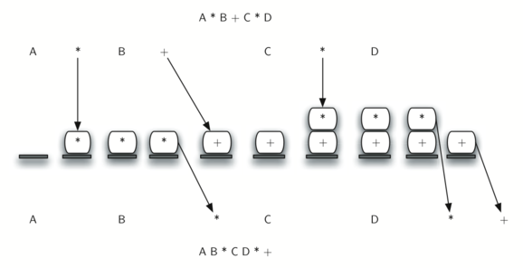
EVALUATION INFIX EXPRESSION TO POSTFIX

Slide 13
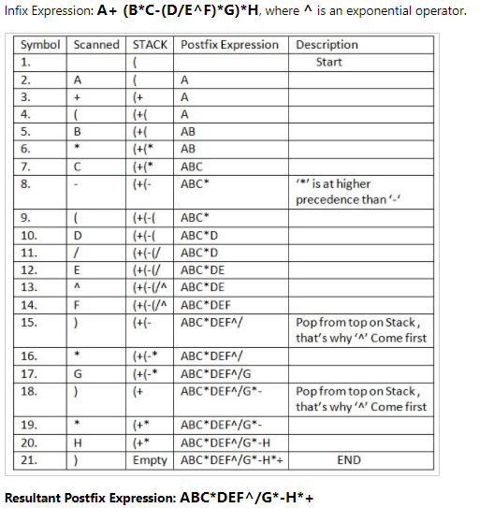

Slide 14
Algorithm for Prefix
Given Infix - ((a/b)+c)-(d+(e*f))
Step 1: Reverse the infix string. Note that while reversing the string you must interchange left and right parentheses.
Step 2: Obtain the postfix expression of the infix expression Step 1.
Step 3: Reverse the postfix expression to get the prefix expression

Slide 15
((a/b)+c)-(d+(e*f))
This is how you convert manually for theory question in the exam
String after reversal – ))f*e(+d(-)c+)b/a((
String after interchanging right and left parenthesis – ((f*e)+d)-(c+(b/a))
Apply postfix

Slide 16
((f*e)+d)-(c+(b/a))
Sr. no. | Expression | Stack | Prefix
0 | ( | ((
1 | ( | (((
2 | f | ((( | f
3 | * | (((* | f
4 | e | (((* | fe
5 | ) | (( | fe*
6 | + | ((+ | fe*
7 | d | ((+ | fe*d
8 | ) | ( | fe*d+
9 | – | (- | fe*d+
10 | ( | (-( | fe*d+
11 | c | (-( | fe*d+c
12 | + | (-(+ | fe*d+c
13 | ( | (-(+( | fe*d+c
14 | b | (-(+( | fe*d+cb
15 | / | (-(+(/ | fe*d+cb
16 | a | (-(+(/ | fe*d+cba
17 | ) | (-(+ | fe*d+cba/
18 | ) | (- | fe*d+cba/+
19 | ) |  | fe*d+cba/+-

